Slide 1
Business Intelligence
overview

Slide 2
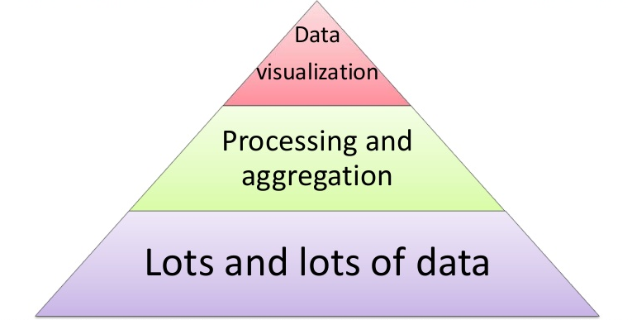
What is BI?
Business intelligence (BI) is a set of theories, methodologies, architectures, and technologies that transform raw data into meaningful and useful information for business purposes.

Slide 3
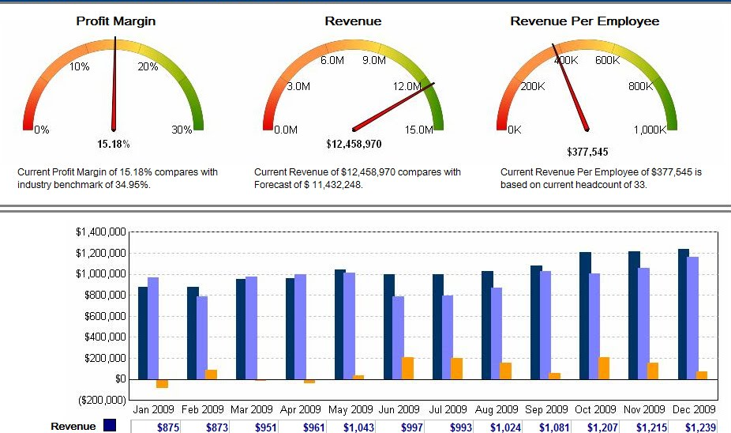
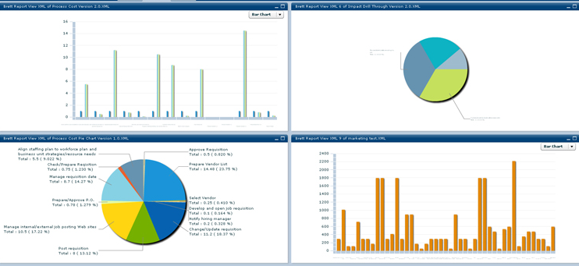
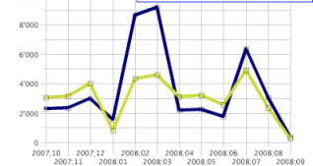
Business Intelligence
Reports
Data repository
Different systems

Slide 4
BI
reporting
data discovery capabilities

Slide 5
Information Delivery
Analysis
Reporting
Interactive visualization
Dashboards
Microsoft Office integration
Search-based data discovery
Ad hoc report/query
Geospatial and location intelligence
Mobile BI
Online analytical processing (OLAP)
Embedded advanced analytics
BI and analytics
(Gartner, 2014)
Integration
BI infrastructure and administration
Collaboration
Metadata management
Business user data mashup and modeling
Embeddable analytics
Development tools
Support for big data sources

Slide 6
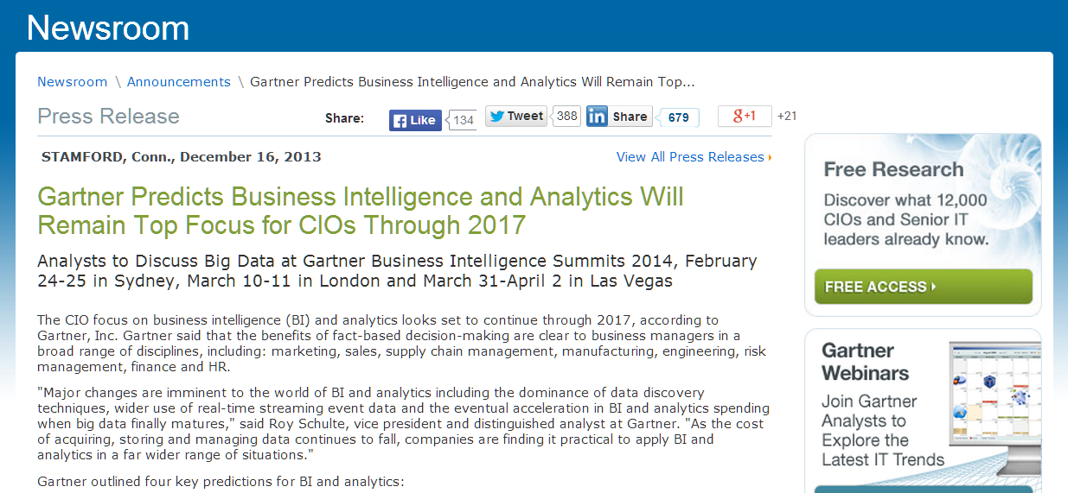
Gartner is the world's leading information technology research and advisory company.
“We deliver the technology-related insight necessary for our clients to make the right decisions, every day”

Slide 7
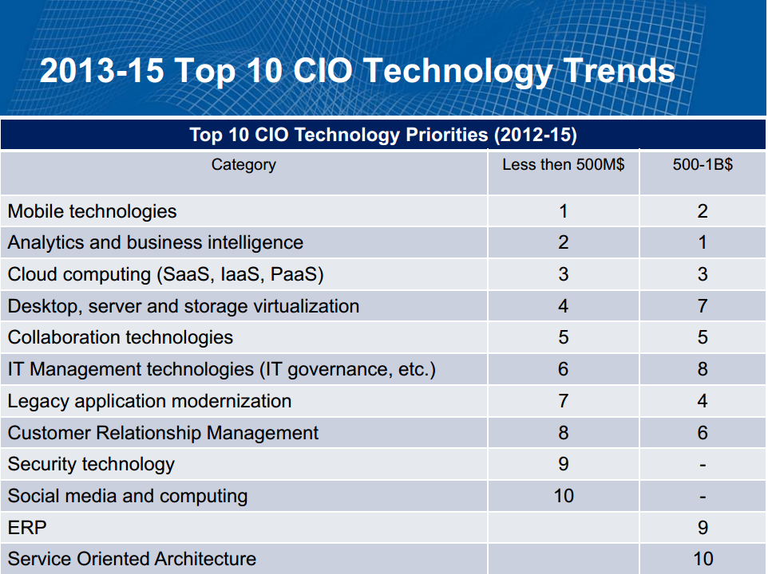

Slide 8
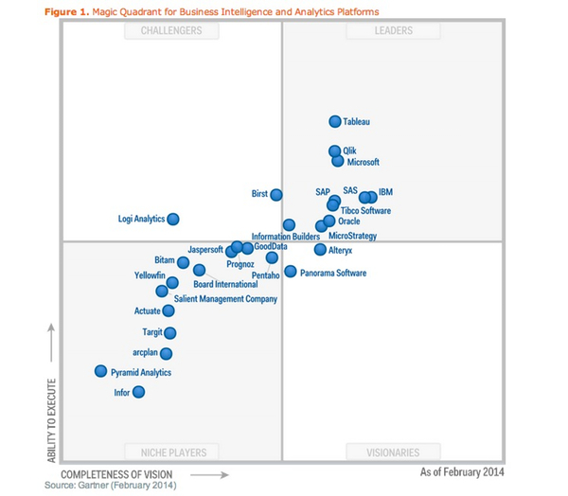
Business intelligence and analytics vendors:
CHALLENGERS
LEADERS
Magic Quadrant report for 2014
(Gartner, feb 2014)
NICHE PLAYERS
VISIONARIES
http://www.gartner.com/technology/reprints.do?id=1-1QLGACN&ct=140210&st=sb

Slide 9
Business management issues
“We have mountains of data in this company, but we can’t access it.”
“We need to slice and dice the data every which way.”
“You’ve got to make it easy for business people to get at the data directly.”
“Just show me what is important.”
“It drives me crazy to have two people present the same business metrics
at a meeting, but with different numbers.”
“We want people to use information to support more fact-based decision making.”

Slide 10
Data Warehouse
The data warehouse:
  must make an organization’s information easily accessible
  must present the organization’s information consistently
  must be adaptive and resilient to change
  must be a secure bastion that protects our information assets
  must serve as the foundation for improved decision making
  the business community must accept the data warehouse if it is to be deemed successful

Slide 11
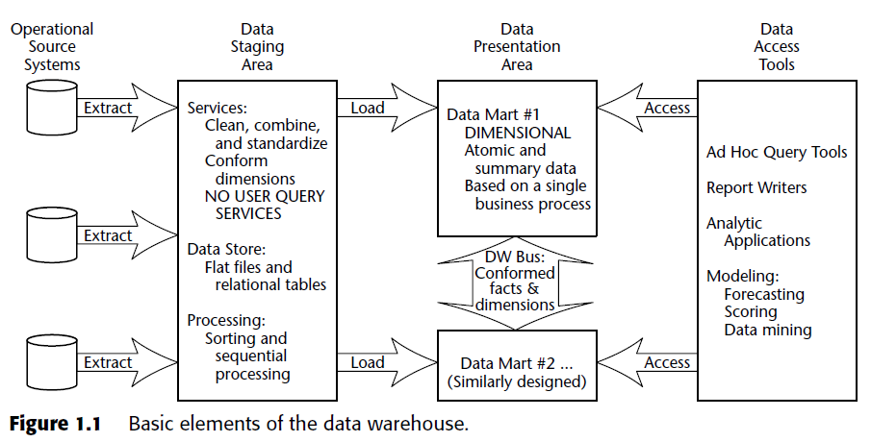
Basic Elements of the Data Warehouse
Ralph Kimball, Margy Ross, The Data Warehouse Toolkit, 2nd Edition, 2002

Slide 12
Operational Source Systems
capture the transactions of the business
queries against source systems are narrow
stovepipe application
Notes:
stovepipe application

Slide 13
Data Staging Area
a storage area
AND
a set of ETL processes
  (extract-transform-load)
it is off-limits to business users and does not provide query and presentation services.

Slide 14
Data Staging Area - ETL
EXTRACTION
  reading and understanding the source data and copying the data needed for the data warehouse into the staging area for further manipulation.
TRANSFORMATION
  cleansing, combining data from multiple sources, deduplicating data, and assigning warehouse keys
LOADING
  loading the data into the data warehouse presentation area

Slide 15
Data Presentation Area
where data is organized, stored and made available for direct querying by users, report writers, and other analytical applications
it is all the business community sees and touches via data access tools
dimensional data modeling
  user understandability
  query performance
  resilience to change
detailed, atomic data

Slide 16
Data Access Tools
tools that query the data in the data warehouse’s presentation area
the variety of capabilities that can be provided to business users to leverage the presentation area for analytic decision making.
  prebuilt parameter-driven analytic applications
  ad hoc query tools
  data mining, modeling, forecasting

Slide 17
Microsoft SQL Server
SQL Server Integration Services (SSIS)
  tool for the ETL process
SQL Server Analysis Services (SSAS)
  tool for multidimensional modeling
SQL Server Reporting Services (SSRS)
  tool for reporting

